Slide 1

China & Japan SRE Team -Automation Use Cases
2020/01/08

Slide 2
1. Automation Implementation Status for SCRM

Slide 3
2. Automation Implementation Milestone for SCRM

Slide 4






1. Data Processor
Extract data from DB and output it to excel, and then edit the date for sending it to requestor automatically.
ASIS
L1 Team
L1 Team
Requestor
Operator
DB
Output data to Excel and edit it manually
TOBE
L1 Team
L1 Team
Requestor
Python＋DB Connecter＋Outlook
Operator
Manually
Automatically
DB
Task Scheduler

Slide 5
2. UI Executor
According the request from business team operator to operate the App or WEB automatically.
ASIS
Business
④Report result
Business System
L1 Team
Operator
A Team
App/web
Ticket
B Team
③Operate
DB
②Check
Ticket
①Request
C Team
TOBE
Business
②Report result
Business System
L1 Team
Operator
A Team
App/web
UIAutomation
B Team
Ticket
Manually
DB
Ticket
Selenium
Automaticlly
①Check & Operate automaticlly
Task Scheduler

Slide 6
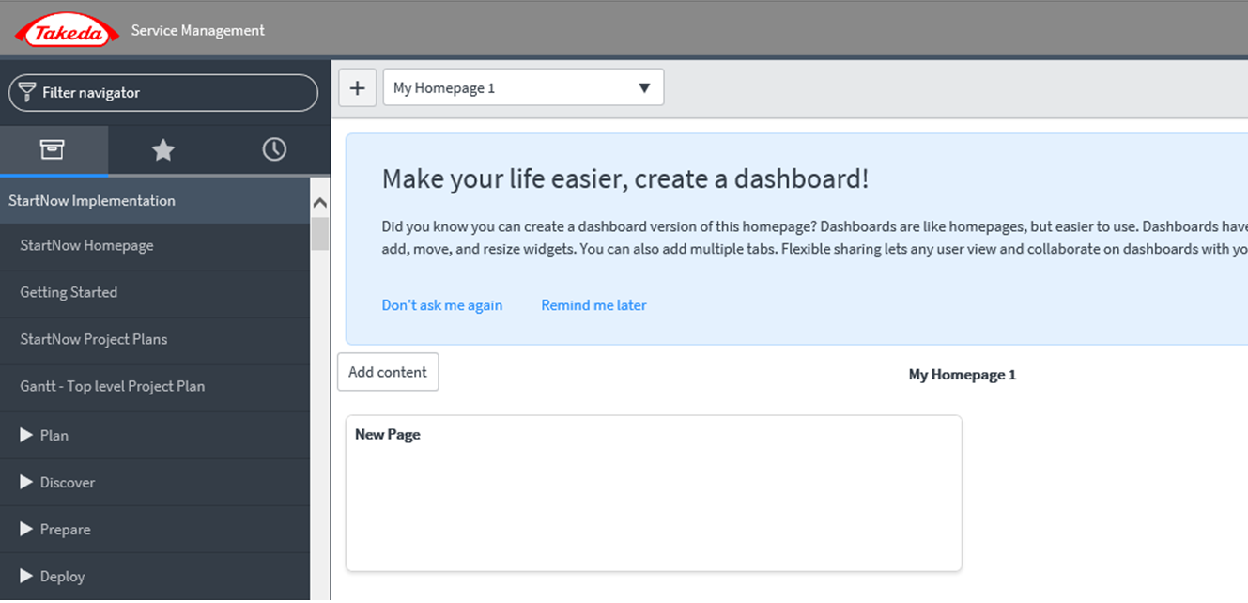

3. Auto Alert Action
Monitoring the Alert mail from JP1 for creating ticket in S-Now automatically.
ASIS
System
L1 Team
L2 Team
JP1
⑤Create ticket in S-Now
AlertMail
IO Operator
IO Operator
Trouble Shooting or
recovery
③check Alert mail
AlertMail
①Send alert mail
②record it to Document
④confirm data in DB or Log
Docs
TOBE
System
L1 Team
L2 Team
JP1
S-Now API
②Record to Docs
③Check email
automatically
AlertMail
⑤Create ticket in S-Now
automatically
Trouble Shooting or
recovery
AlertMail
IO Operator
①Alert Mail Monitoring
Docs
L2 Task
④confirm data in DB or Log

Slide 7
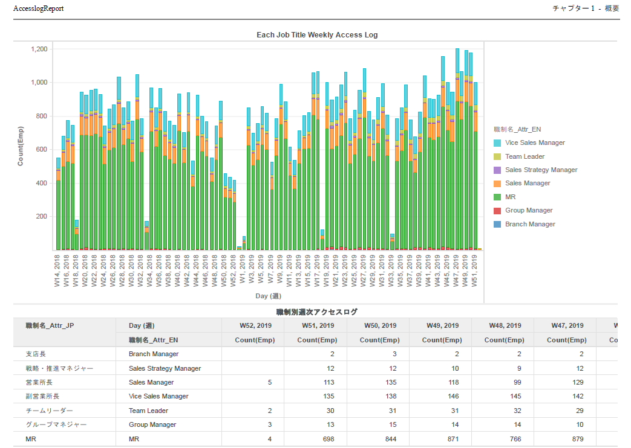



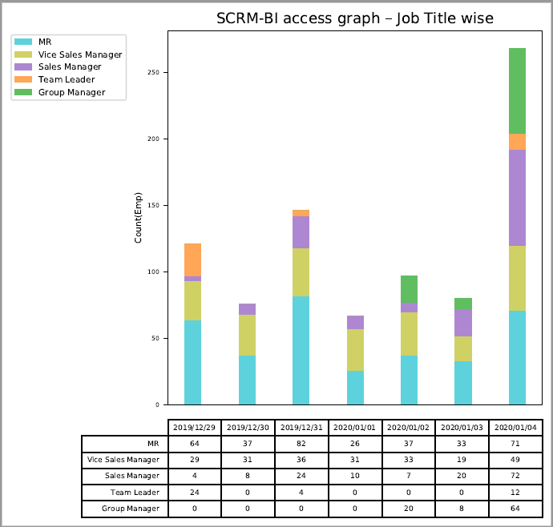
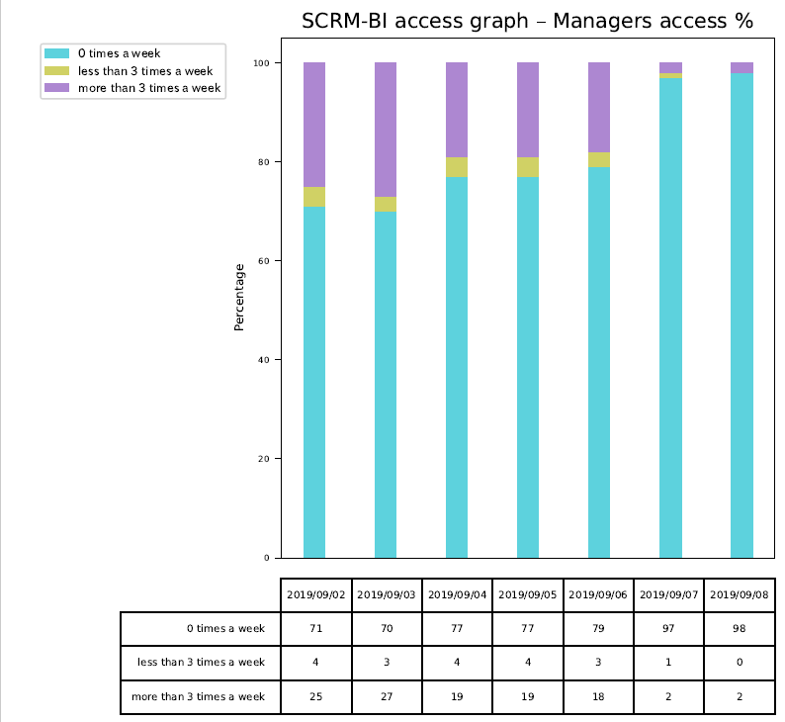
4. Automatic Report Provider
Output a report from MSTR for confirming system access statistics
ASIS
MSTR
Enterprise Manager
Statistics by count
Feasibility
Not available
Statistics by %
ToBe
MSTR
Enterprise Manager
Statistics by count
RAW Data
Statistics by %

